Slide 1
SAP Datascience Enablement

Slide 2
Agenda
Introduction to Machine Learning – Types and Challenges
Introduction to Deep learning – Neural Networks
Introduction to Natural Language Processing
Machine Learning and Deep learning with SAP Leonardo ML Foundation
SAP Leonardo Machine Learning Foundation Architecture
SAP Leonardo ML Foundation Functional Services
SAP Leonardo ML Foundation Services – Example Scenarios
ML Foundation Service Enablement
ML Foundation Retraining
BYOM (Bring Your Own Model)

Slide 3
Introduction to ML:
What Is Machine Learning?
Machine Learning is the science (and art) of programming computers so they can learn from data
OR
Machine Learning is the field of study that gives computers the ability to learn without being explicitly programmed.
Why learn from data? Why not rule based program?
Traditional Approach
Machine learning Approach
Advantages:
Learns from data and create automatic rules
Program is much shorter and easier to maintain
Most likely more accurate and easily scalable by introducing new set of data for learning
Challenges:
Rule based programming
Program will likely become long list of complex rules
Not easily scalable and tough to maintain

Slide 4
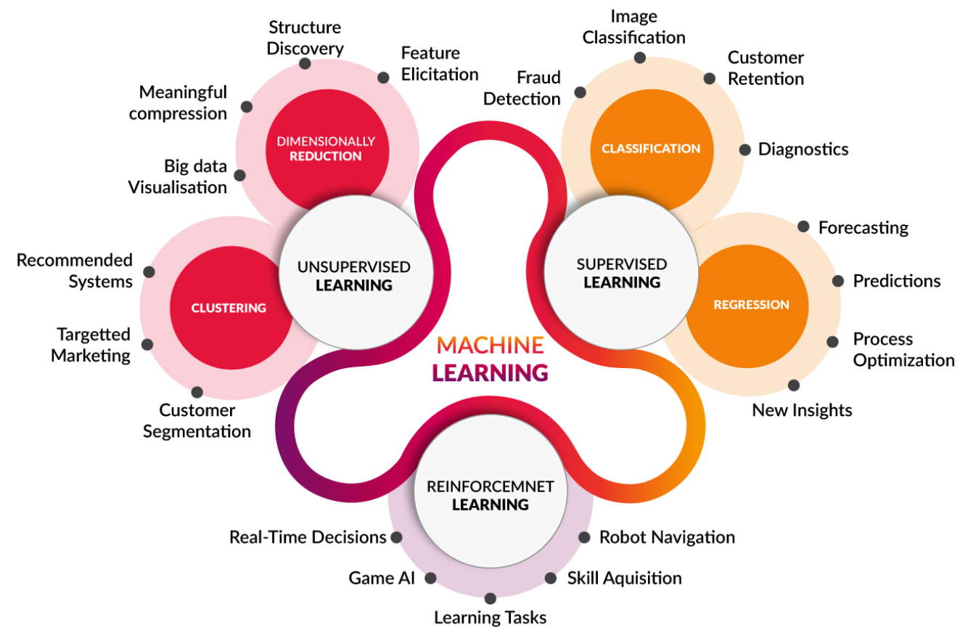
Types Of Machine Learning..?

Slide 5




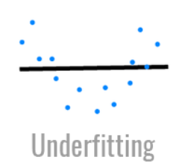
Challenges of Machine Learning
Insufficient Quantity of Training Data
Poor-Quality Data
Irrelevant Features
Even very simple problems typically need thousands of examples
Complex problems such as image or speech recognition may need millions of examples
Not always easy or cheap to get extra training data
Harder for the system to detect the underlying patterns due to poor quality
System less likely to perform well in case of poor data quality
Maximum efforts spent on data cleansing
Require additional efforts on selecting the most useful features to train on among existing features
Require additional efforts on combining existing features to produce a more useful one
Requires gathering new data to create new features
Overfitting the Training
Data
Underfitting the Training
Data
Model performs well on the training data, but it does not generalize well.
Noisy data set or small data set leads to detect the pattern in the noise itself resulting to the overfitting of the model
Occurs when the model is too simple to learn the underlying structure of the data
Requires re selecting a more powerful model, with more parameters

Slide 6
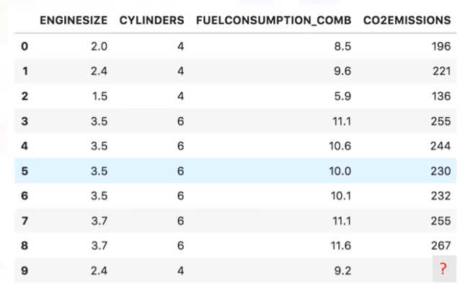
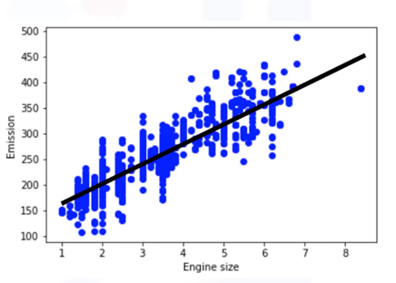
Regression:
Regression Analysis is the technique of studying the dependence of one variable(Dependent Variable) on one or more variables (Independent Variable) in view to predict the value of the Dependent variable against the fixed value of Independent variable
Dependent Variable – CO2EMISSION
Independent Variable – ENGINE SIZE
Regression – Predict the value of CO2EMISSION with respect to the value of ENGINESIZE
Independent Variable
Dependent Variable
y’ = b0 + b1x ± є
y’ – Predicted value
b1 – Slope of line, b0 – Intercept
Є - Error

Slide 7
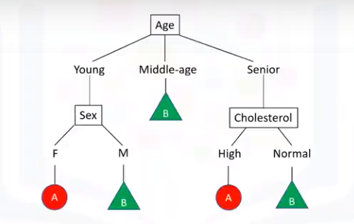
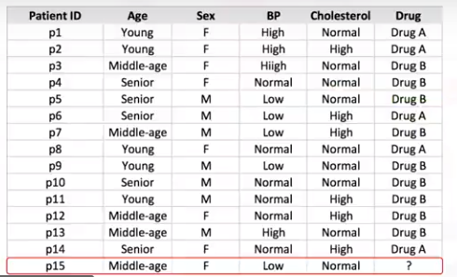
Classification:
Classification is the supervised learning that deals with identifying the class to which an instance belongs
Independent Variables
Dependent Variable
The above example shows the decision tree based classification example
Predict the category of Drug(A or B) based on the previous labelled data

Slide 8
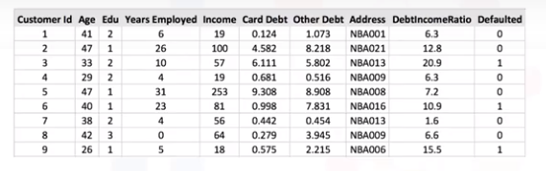
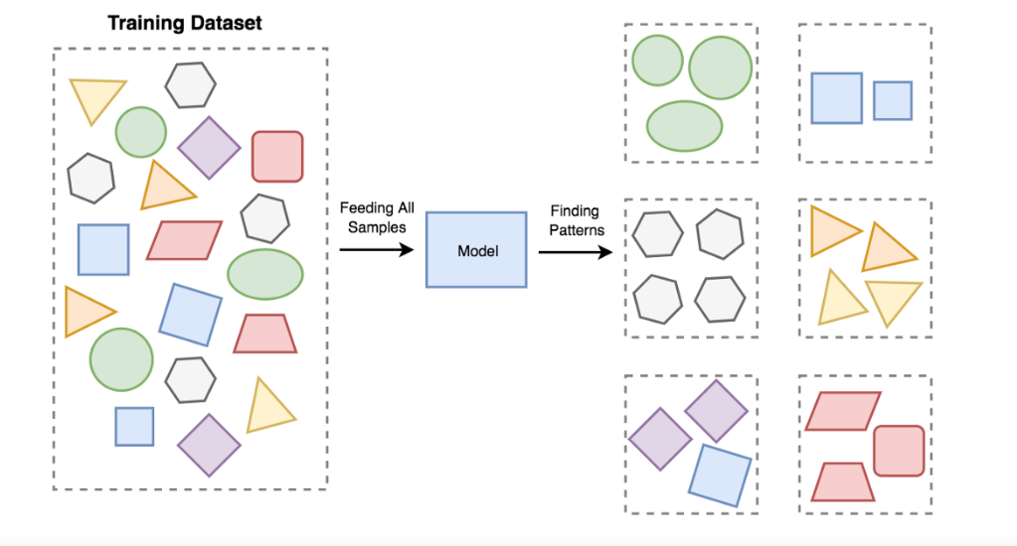

Clustering:
Clustering is a Machine Learning technique that involves the grouping of data points. Given a set of data points
Customer data, which needs to be segmented
The organization of unlabeled data into similarity groups called clusters
Collection of data items which are “similar” between them, and “dissimilar” to data items in other clusters.
Clustering Algorithm.
Ex K-Means
Customer segmentation through clustering

Slide 9


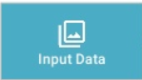
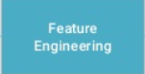
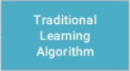



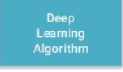
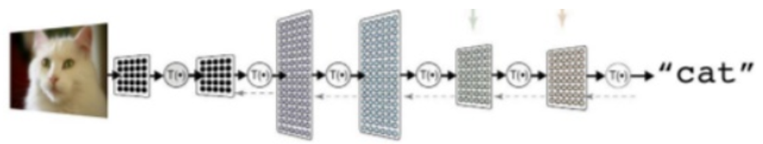
Deep Learning
Part of machine learning filed of learning representations of data, which has exceptional effect at learning pattern
What is Deep learning?
Utilizes Artificial Neural networks the derives meaning out of data by using multiple layers that mimic neural network of our brain
Why Deep learning?
Traditional method
Cost lot of time
Deep learning
How Deep learning works?
Deep learning uses deep artificial neural networks that consists of Hierarchy of layers, whereby each layer transforms the input data into more abstract representations (e.g. edge->nose->face). The output layer combines those features to make a prediction

Slide 10
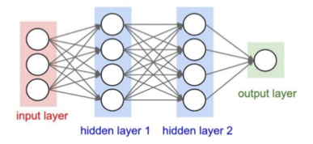
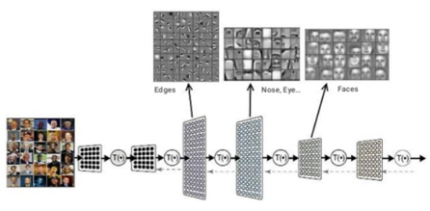
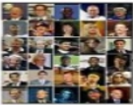
Neural Networks
Artificial Neural Network
Consists of one input, one output and multiple fully-connected hidden layers in between. Each layer is represented as a series of neurons and progressively extract higher and higher level features of the input until the final layer essentially makes the decision about what input shows. The more layers network has, the higher level of features it will learn.
Neurons are trained to filter and detect specific features or patterns by receiving weighted inputs, transforming it with an activation function and passing it to the outgoing connection
Example
The Neural network for image processing, consisting of various middle layers which extracts various features like edges, nose, eyes out of input image containing faces and finally arrive at the output
Forward it through the network to get predictions
The Training Process
Sample labelled image
The neural network learns by generating an error signal that measures the difference between the predictions of the network and the desired values and then using this error signal to change the weights(or parameters) so that predictions get more accurate
Update the connection weights
Back propagate the errors

Slide 11
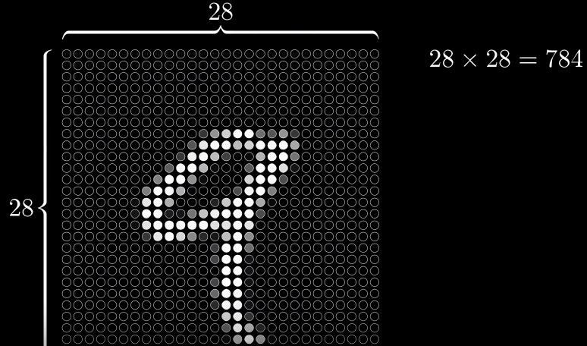
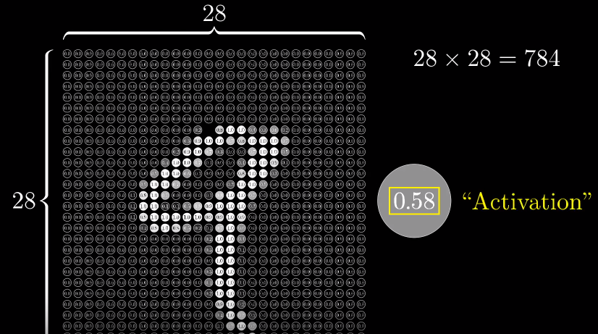



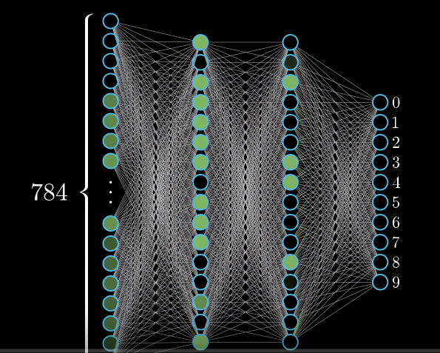

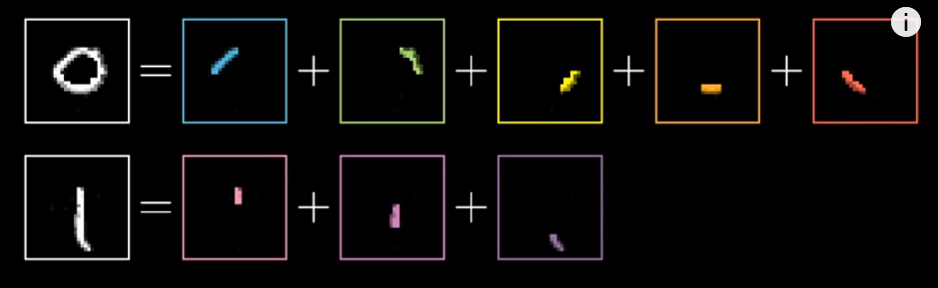
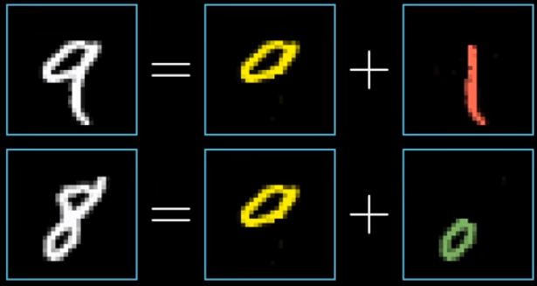
Detecting Hand Recognition
Hidden Layers

Slide 12
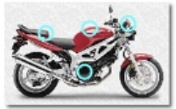
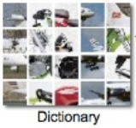

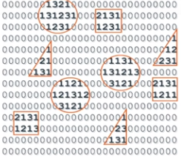
Types of Neural Networks
Type | Application
Feedforward Neural Network | Face recognition Computer vision
Convolutional Neural Network | Signal processing Image classification Image analysis and recognition
Recurrent Neural Network(RNN) – Long Short Term Memory | Natural language Procession Text-to-speech conversion technology
Multilayer Perceptron | Speech recognition Machine translation technologies
Radial Basis Function Neural Network | Power restoration systems
Unlabelled (Unsupervised Learning) | Labelled (Supervised Learning)
Feature Extraction | Text Processing
 | Image Recognition
Pattern Recognition | Object Detection
 | Speech recognition
Examples – RBM, Auto-encoders | Examples - RNTN, RECURRENT NET, DBN, CONVOLUTIONAL NET
Feature Extraction transforms raw data into features that can be used as an input for a learning algorithm
Language Translation
Sentiment Analysis
Spam Filtering
Feature
Visual
Words
Image recognition can transform your smartphone into a virtual showroom
Cars of the future are expected to detect obstacles and warn you about proximity to guardrails and walkways
Stock Market Forecasting
Text Generation
Signature Verification
Automatic reading of radiology images
Tracking a person in a video.
Conversational AI (Alexa, Siri, Google Assistant)

Slide 13
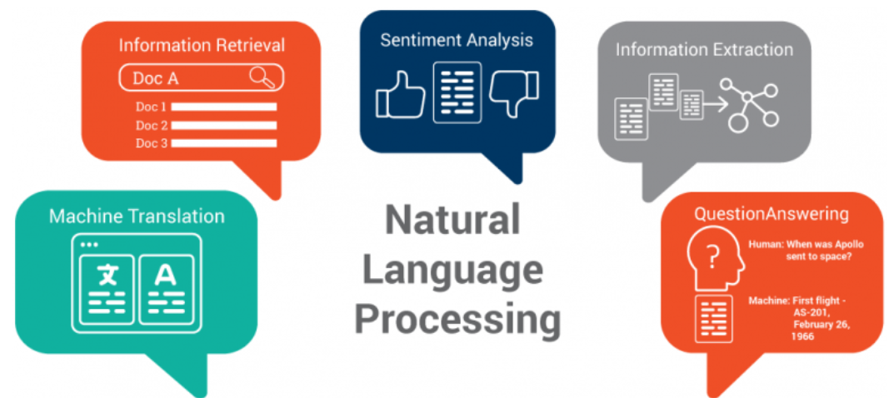
Natural Language Processing
NLP is a way for computers to analyze human language and derive useful meaning from it
It is a field of AI that deals with how computers and humans interact and how to program computers to process and analyze huge amounts of natural language data.
Sentiment analysis exists to learn what was said about that topic — was it good or bad? Sentiment analysis systems can take this unstructured data and automatically add structure to it, capturing the public’s opinion about products, services, brands, politics, etc.E.g. Product review analysis
Information Retrieval is about finding relevant resources to an information need from a humongous collection of resources. Due to dominance of textual data over internet, primary task of any IR system is to process those text where NLP plays pivotal role. Eg. Searching for a specific skilled employee from employee’s CV database
Information extraction (IE) is the task of automatically extracting structured information from unstructured and/or semi-structured machine-readable documents. E.g. Extracting skill set from CVs
Question answering (QA) is a discipline within the fields of information retrieval and natural language processing (NLP), which is concerned with building systems that automatically answer questions posed by humans in a natural language. E.g. Chatbots
Machine translation is a sub-field of computational linguistics that investigates the use of software to translate text or speech from one language to another. E.g. Google translator

Slide 14
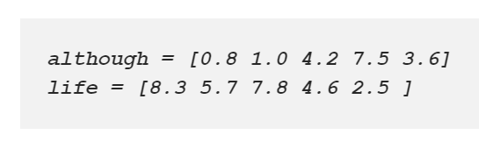
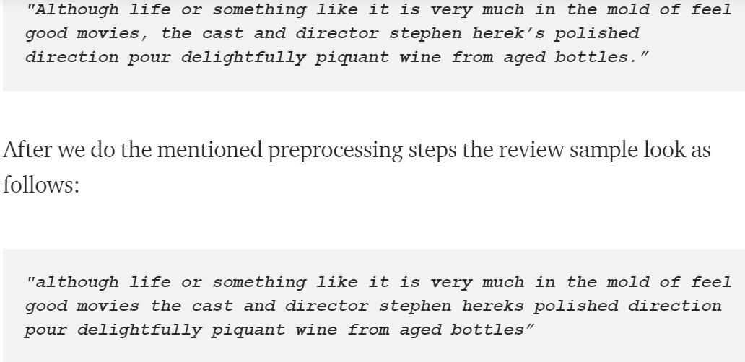
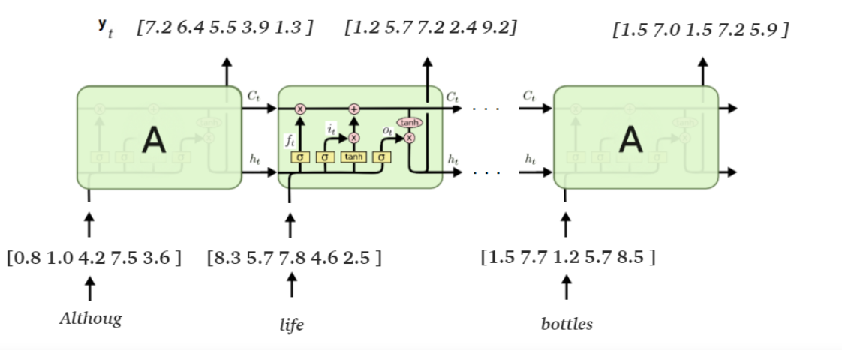
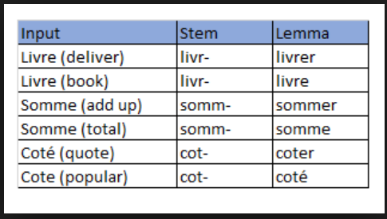
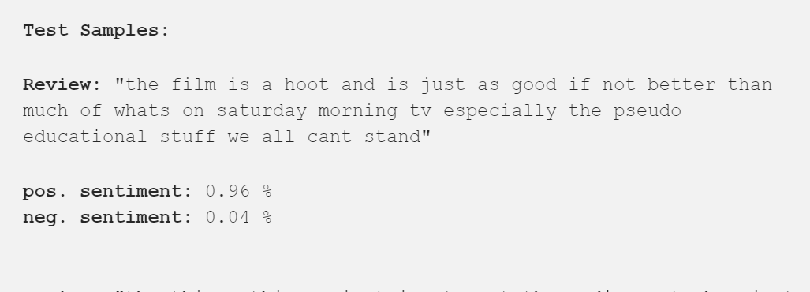
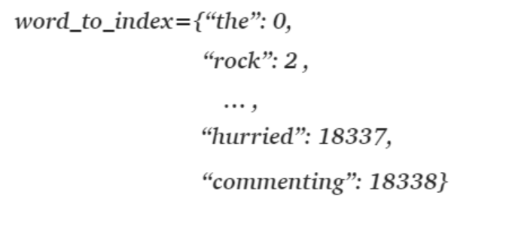
Sentimental Analysis Use case:
Consider the words such as ”Something” and “something”. For us humans these words have the same meaning, the only difference between them is that the first word is capitalized, because it may be the first word in a sentence. But for the neural network, these words will have (at the beginning at least) a different meaning because of their different spelling. Only during training, the neural network may or may not learn to recognize that these words mean the same. Our aim is to prevent such misconceptions.
Word Embedding's
Data
Uniform Spelling Of words
Preprocessing
Removing Special Characters
Stemming and Lemmatization
Sentiments
Word To Index

Slide 15
Machine Learning and Deep Learning with SAP Leonardo Machine Learning foundation
Intelligent Applications
Leonardo Machine learning foundation Offers set of Machine learning and deep learning capabilities as pre trained ready to use API’s, which can be consumed directly into the application. Also it offers the infrastructure required for model retraining and model repository
SAP Leonardo Machine learning foundation
API, Bindings, wrappers
Functional services
Predictive services
Training and lifecycle management
Functional services
Include consumable pre-trained models that can be used as a web services by calling simple REST.
Document Feature Extraction API
Image Classification API
Image Feature Extraction API
Time Series Forecast API
Topic Detection API
Product Text Classification API
Similarity scoring API
Training infrastructure
Data preparation
Algorithm libraries
Resource manager
Business services
Geospatial Services
SAP Cloud Platform
Predictive Services
Include Predictive services consumable through REST API’s
Clustering service
Dataset service
Forecast service
Outlier service
Recommendation service
What if service
Training infrastructure and Repository
In addition to the standard services, ML foundation offers required infrastructure for deployment of custom models(BYOM) through model repositories and offers the storage infrastructure to store training data to retrain the standard delivered models
Geospatial Services
APIs to retrieve location based information that can be leveraged for geospatial processing
Point of interest services
Earth Observation Analysis

Slide 16



SAP Leonardo Machine Learning Foundation Architecture
Client Application
Consume RESTful services in the client application for inference
Application Tier
SCP Cloud Foundry
Expose the standard and custom machine learning and deep learning models as RESTful services
SAP Leonardo ML Foundation APIs
Tenant Onboarding
Use Case Business Logic
(Training and Inference)
Compute Tier
Container Service (Kubernetes / Docker)
TensorFlow
Serving
Model
Containers
TensorFlow
Training
Containers
Other
Containers
(R, Scikit)
Containerization to provide required runtimes for the models deployed
Persistence Tier
Model Repository to store external models which re deployed to fulfill custom requirements
Model Repository
Big Data Storage

Slide 17



Leonardo Standard Functional Services
Type | Use case | Standard API’s
Which Objects are shown in image?
Customizable Image Classification
Customizable Image Object Detection
Human Detection; Face Detection
Customizable Image feature extraction
Optical Character Recognition(OCR)
Scene Text Recognition
Image Segmentation
What is the text displayed in Image?
Image
Which Pictures show identical Persons?
How to convert Speech to written
Text and vice-versa?
Speech To Text
Text To Speech
Speech
How can I match text contents or
Classify them??
Customizable text classification
Text Feature Extraction
Topic Detection
Language Detection
Translation
Customizable Similarity Scoring
What is the topic of an article?
Text

Slide 18


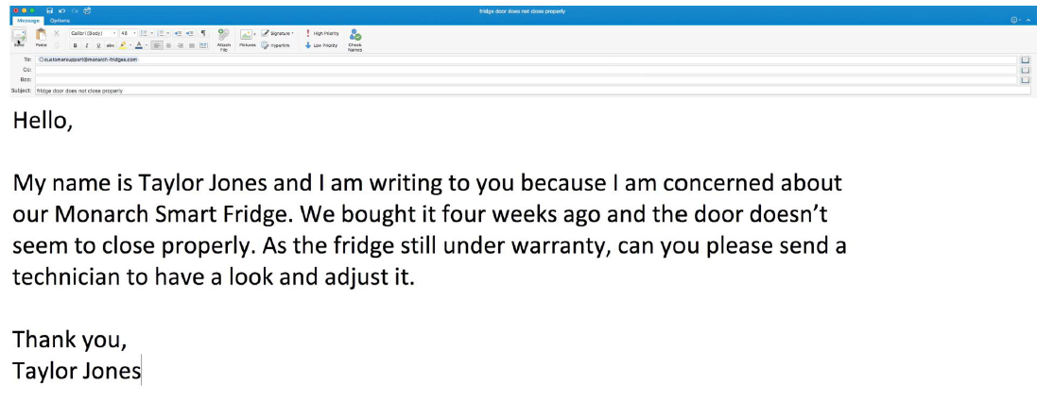







ML Foundation service application – Example Scenario
SAP Service Ticket Intelligence application processes customer queries automatically to deliver best in class customer service
Classification
Customer Query
Leonardo Machine learning Algorithm
Identify recommended solutions
Routing
Resolution
Specialized Teams
Improved service response times with automated processing
Based on the REST API, the functionality can be integrated in any software stack
Enabled to scale customer service with increased digital interactions

Slide 19
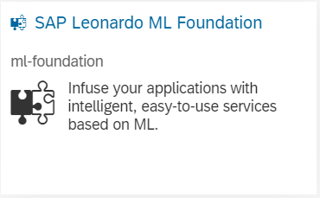
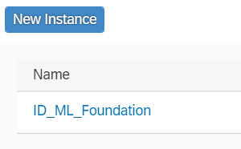
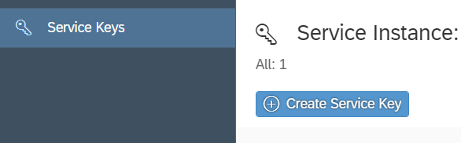
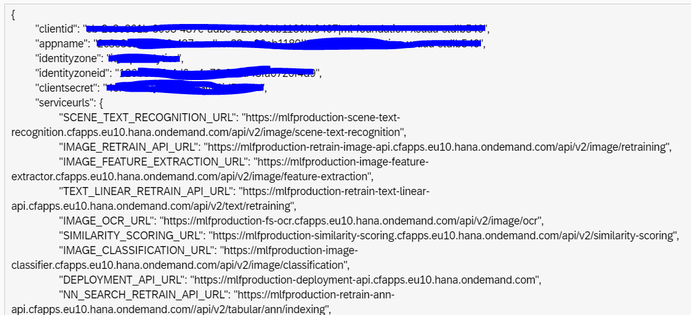
ML Foundation service enablement
Prerequisite
License/Subscription to Leonardo ML foundation service
Can be enabled and leveraged only for Cloud Foundry environment, hence require the space created in cloud foundry environment
Create Service Key
Create new service key by clicking on “Create Service Key”
Service Marketplace
Search for SAP Leonardo ML Foundation service
in the service marketplace
Service Instance
Create new service instance
Generated Service keys
Generate new service keys for the new instance
The service key generation creates Client_id and Client_secret which is required to create the OAuth token
The OAuth token is required to consume any Leonardo ML foundation API’s
Leonardo ML foundation services are ready to be consumed as well as retrained
Model deployment feature to bring custom model is also enabled

Slide 20


SAP Leonardo ML Foundation - Retraining
Suppose we own a flower shop, and our requirement is to identify the species of flower from an image.
The output of the model is overly generalized and doesn’t suite our business requirements.
As we own a flower shop 99% of the images we process will be of a flower.
“Flower”
Image Classification Model
Thus we need to make our model more specific to our business. We don’t care if our model can classify a tiger from a lion, What we do care is that it can correctly classify the images of different flowers.
Now if we re-train our Image-Classification model with only images of different flowers, It should be able to give us correct result.
SAP Leonardo has many retrain-able services like
Image-Classification
Text-Feature Extraction
Text-Classification
SAP Leonardo ML foundation has separate API URLs for retraining.
Re Trained
“Tulip”
Image Classification Model

Slide 21




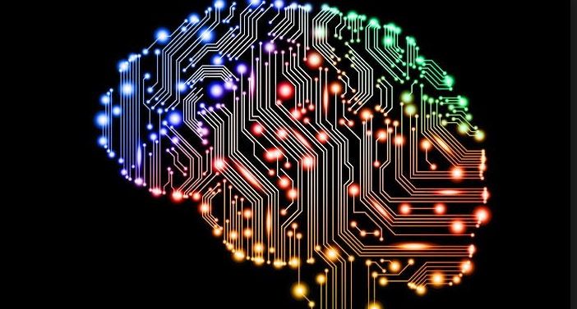
SAP Leonardo ML Foundation - BYOM
In addition to the pre-built services and APIs, ML Foundation also supports deployment of external models through the concept of “Bring Your Own Model(BYOM)” and create inference on top of the model.
SAP Leonardo currently supports Tensorflow models, Scikit and R models.
Supported versions of Tensorflow are - 1.3, 1.7, 1.8, and 1.11
We need a model in a ‘saved_model’ or ‘.pb’ format
BYOM Process
Upload/Import
the saved model
to cloud foundry
using CLI
or Swagger
Create a python
application for inference
Push the Application
To cloud foundry
Deploy uploaded model into the model server
To consume the
Model through the application URL

Slide 22
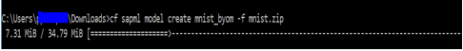
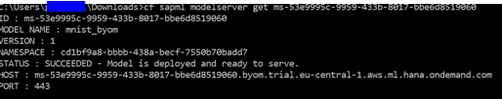
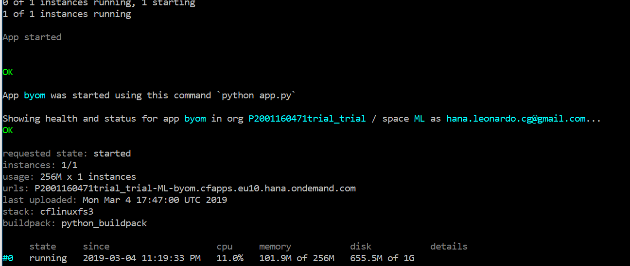
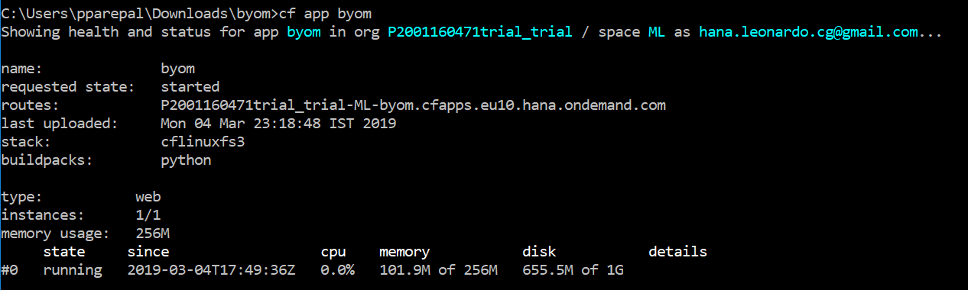
SAP Leonardo ML Foundation - BYOM
Deploy Model
Deploy the saved model in SAP Leonardo cloud foundry.
Model Server
Deploy Model in Model Server assigning it a Resource plan.
Create Inference
Create an app for inference and push it to the cloud.
Model Ready
Note the ID of the model.
Model Deployed and Ready to be consumed
We can use the API generated to consume the model

Slide 23
ID SAP
SAP Leonardo
Thank you

